Slide 1
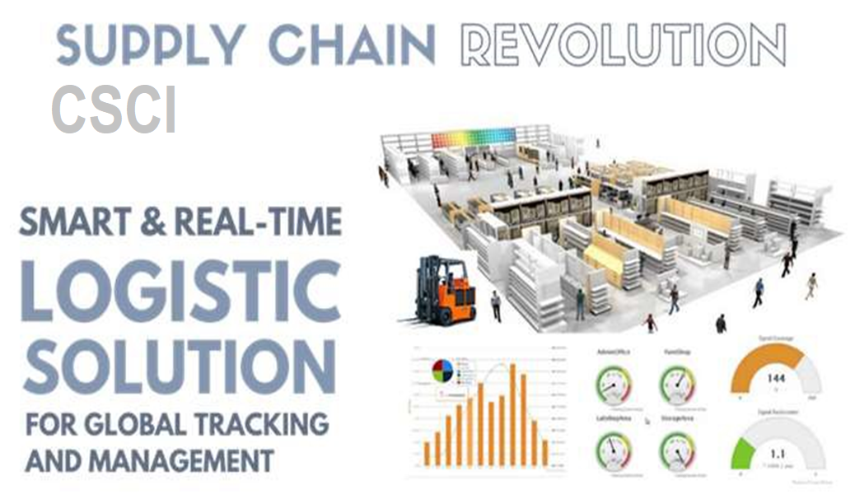
Notes:
Design Time Real-Time RFID Asset Tracking on the Cloud

Slide 2
Current limitations of RFID systems
Problem
Existing systems do not provide real-time tracking, they only track the last point in time.
Expensive deployment of RFID systems locally without scalability
A bottleneck in asset inventory - A standard RFID reader seamlessly processes 6 to 10 k of resources
Limitations in the Big Data analysis - no analysis and forecasting trends
This approach is not enough
For global warehousing, sorting, logistics, or production environments
Notes:
No real time tag tracking available
Only last position / location information available
Long implementation time (local visions and design) and high implementation costs
Narrow throat in stock inventory
Industry standard reader processes seamlessly 6-10k RFID tags per hour (actually per hour ??)
Limited application possibilities in measuring and optimizing business processes (delayed collection of information, lack of ongoing analysis and forecasting)
Text in red:
The above limits the areas of application and is not able to meet expectations

Slide 3
RFID Platform on the Cloud
Solution
New approach to RFID - Real-time access to information - The ability to capture the course of business processes at any time
 | Implementation Plug & play class |  | 3D Cad Design instead of costly audits
Real time collection and processing of information |  | Integration with any system and sensor |  | Global tracking of resources from multiple locations
Accelerate real-time analytical processes
Notes:
From left:
Collection and processing of information in real time
Easy implementation (plug & play)
Integration with any system and sensor
Eliminate costly audits with 3D CAD design
Simultaneous data tracing from different locations

Slide 4

Benefits
Lower costs and loss prevention
Transparency through delivery channels
Reduce time to locate , count and track assets
Real-Time Process automation - no manual scanning
There is no cost to buy expensive servers and additional IT staff
Real-time reporting – better decision making forecasting for management
Enhance the safety of workers, equipment, internal fleet of vehicles; reducing mishaps
Notes:
From the top:
Reduce logistics costs and product losses
Increase revenue by increasing transaction volume
Shortening the inventory time of fixed assets
There is no cost to buy servers and maintain your systems by using
Access to real-time information - immediate response to events
Forecasting and planning with accurate information
Increase the safety of employees, equipment, internal fleet of vehicles (I do not know if this is left ...)

Slide 5
Areas of ​​application
Warehouse / sorting
/ sortownia
Access control / employee monitoring
Logistics / Supply Chain
Medical / Hospital
Manufacturing
Airline Baggage Tracking
Notes:
Manufacturing and Processing
Inventory and production process monitoring
Warehouse order fulfillment
Supply Chain Management
Inventory tracking systems
Logistics management
Retail
Inventory control and customer insight
Auto checkout with reverse logistics
Security
Access control
Counterfeiting and Theft control/prevention
Location Tracking (including Airline Baggage)
Traffic movement control and parking management
Wildlife/Livestock monitoring and tracking

Slide 6
Application: Current Pilot Polish National Post
Shipping monitoring - priority / value /
Traceability of fixed assets (e.g. WER / WER carts)
Monitoring workers' work - in which zones / time they spend
Possibility to introduce additional processes - such as handling and tracking of dangerous goods (ADR)

Slide 7
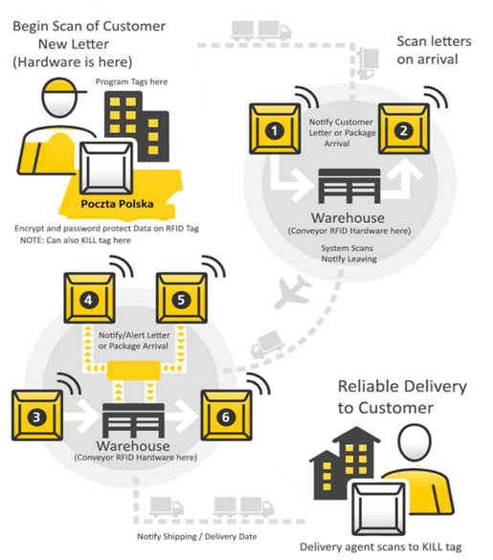
(Cont): Current Pilot Polish National Post
Pilot currently in progress to automate processes, reduce the time and cost of shipping the items, work out metrics to implement the project on a larger scale.
  Awaited results:
  Correcting logistical processes, introducing automatic inventory of consignments
  Tracking and zone localization of consignments in a closed chain (from dispatch to delivery)
  Confirmation of the possibility of scaling future solutions to further distribution centers
Notes:
Still in Progress.. Will be published in September 2017

Slide 8
Business model
Comparison to other RFID solutions
 | ProxiTrak | Other
Site Survey | $ 0 | $ 100 k
Scalability - Infrastructure development | $ 0 | $ 50-100 k
IT costs (+ Service equipment) | $ 500 / cloud | $ 150 k
Build / purchase software | SAAS, monthly subscription | $ 500 k
Monthly license
licencja
Depends on the number of readers
Monthly maintenance
As a percentage of the license value
Notes:
PaaS allows you to avoid the expense and complexity of buying and managing software licenses, the underlying application infrastructure and middleware or the development tools and other resources. You manage the applications and services you develop, and the cloud service provider typically manages everything else.

Slide 9


CSCI Contact Info:
cliftena.carter@csci-online.com
+001 913 607 6501

